Slide 1
Lessons of the Past,
Tools of the Future
A Computational Decipherment of
Linear B
Katie Paxton-Fear
PhD student in Defence and Security
Cranfield University
K.Paxton-Fear@cranfield.ac.uk
Notes:
1

Slide 2

Creativity is Limitation
Limitation: Follow the steps of the original decipherment
  “Standing on the Shoulders of Giants”
A different approach to a interdisciplinary project
Composition with Red Blue and Yellow, Piet Mondrian 1930
Notes:
2

Slide 3
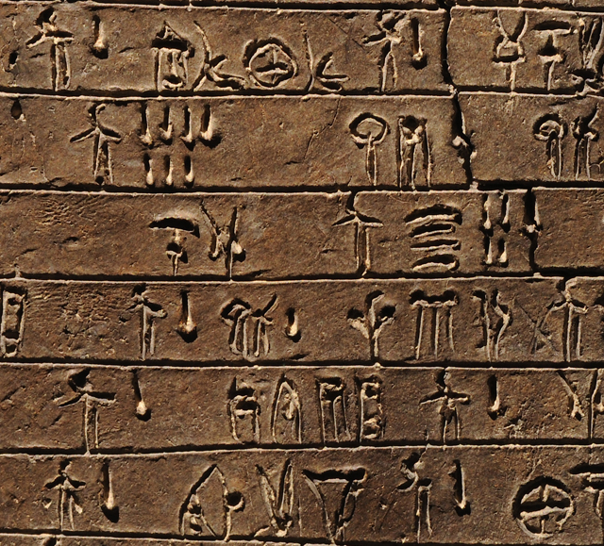
Background
Linear B was found on Crete and at select places on the mainland
It is a syllabic language
The language was used administratively
Related languages
  Linear A, Cypro-Minoan, Cretan Hieroglyphs, Classical Cypriot

Slide 4
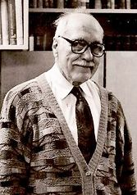
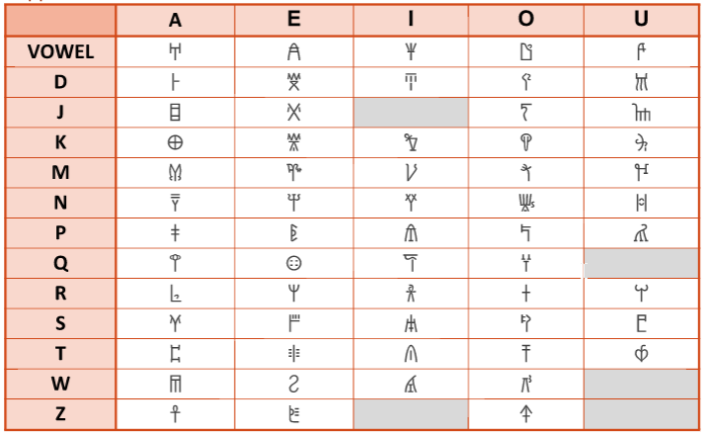
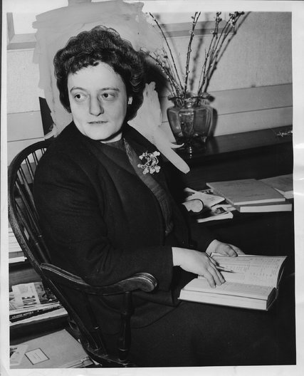
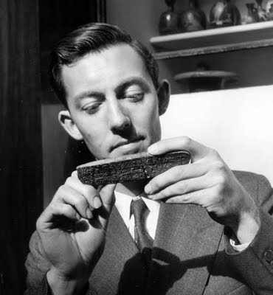
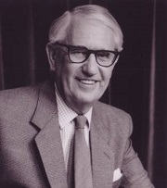
A Recipe for Decipherment
1) Correctly classify and transcribe tablets
  Completed by Emmett L. Bennett Jr.
2) Find evidence of inflection
  Completed by Alice Kober
3) Create a grid of characters
  Completed by Michael Ventris
4) Begin assigning likely values to the grid
  Completed by John Chadwick & Ventris
Notes:
4

Slide 5
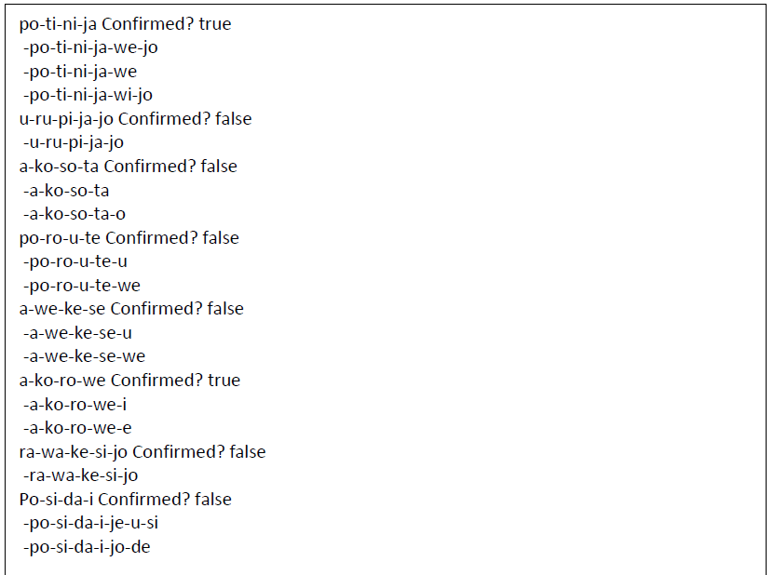
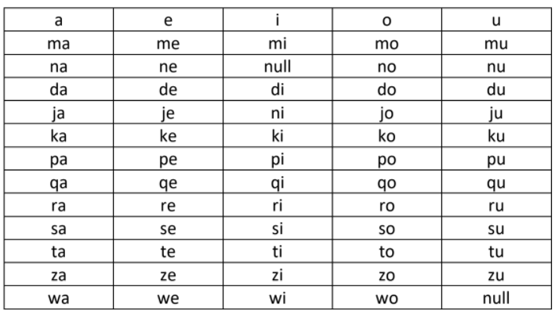
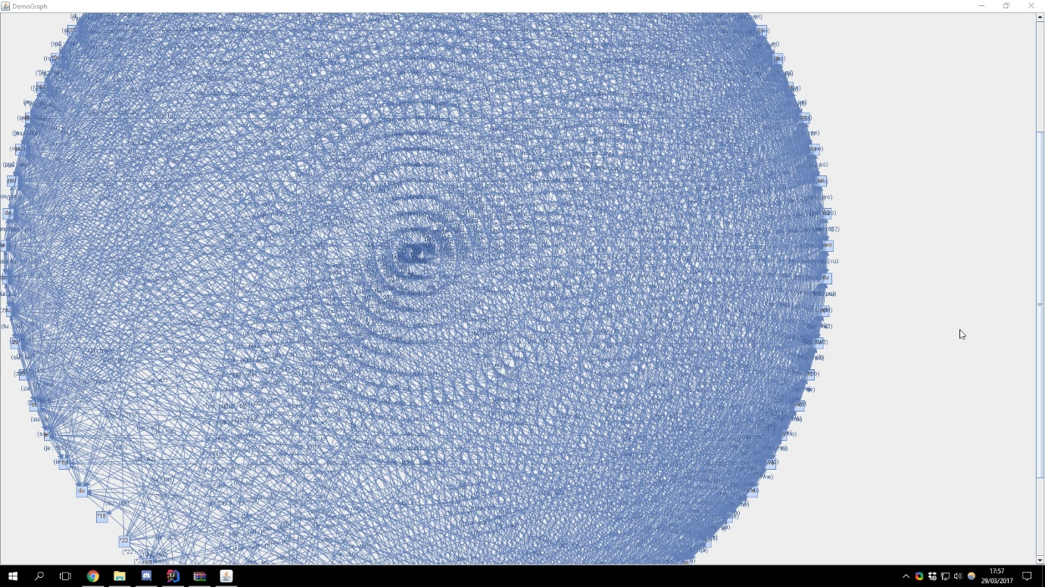
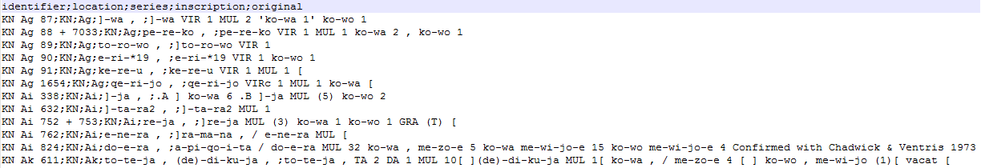
System flow
Every tablet
Find inflection
A graph showing shared vowels/ consonants
Final grid of values
Output
Notes:
5

Slide 6
Finding Inflection
Kober originally found evidence that Linear B was inflected
Kober’s algorithm
  Select words which are followed by ideograms and numerals
  Find the same word in different contexts
  Find predictable patterns where the word endings change
 | Type A |  | Type B
Case I | 𐀬 𐀑 𐀴 𐀊 | 𐀞 𐀂 𐀴 𐀊 | 𐀶 𐀪 𐀯 𐀊 | 𐀒 𐀜 𐀯 𐀊 | 𐀦 𐀖 𐀛 𐀊
Case II | 𐀬 𐀑 𐀴 𐀍 | 𐀞 𐀂 𐀴 𐀍 | 𐀶 𐀪 𐀯 𐀍 | 𐀒 𐀜 𐀯 𐀍 | 𐀦 𐀖 𐀛 𐀍
Case III | 𐀬 𐀑 𐀵 | 𐀞 𐀂 𐀵 | 𐀶 𐀪 𐀰 | 𐀒 𐀜 𐀰 | 𐀦 𐀖 𐀛 𐀰
 | Type C | Type D | Type E
Case I | 𐀪 𐀍 𐀛 𐀊 | 𐀶 𐀖 𐀊 | 𐀫 𐀹 𐀊
Case II | 𐀪 𐀍 𐀛 𐀍 | 𐀶 𐀖 𐀍 | 𐀫 𐀹 𐀍
Case III | 𐀪 𐀍 𐀰 | 𐀶 𐀗 | 𐀫 𐀺
Notes:
6

Slide 7
Inflection Algorithm
A visual representation
Loop through each word
  Loop through each word
    If the word is exactly the same – ignore
    Else
      Loop through the characters in word 1
        Does this character match the character in word 2
          Increase the similarity
        Else – stop, these words are dissimilar
walk
talking
walking
wanting
walked
[w,a,l,k]
[t,a,l,k,i,n,g]
[w,a,l,k,i,n,g] [w,a,n,t,i,n,g]
[w,a,l,k,e,d]
Loop | Word 1 | Word 2 | Similarity
1 | walk | walk | 0
2 | walk | talking | 0
3 | walk | walking | 4
4 | walk | wanting | 2
Loop | walk | talk | Similarity
1 | w | t | 0
Loop | walk | walking | Similarity
1 | w | w | 1
2 | … | … | …
4 | K | K | 4
Loop | walk | wanting | Similarity
1 | w | w | 1
2 | a | a | 2
3 | l | n | 2
Notes:
7

Slide 8
Inflection Results
po-ti-ni-ja Confirmed? true
-po-ti-ni-ja-we-jo
-po-ti-ni-ja-we
-po-ti-ni-ja-wi-jo
u-ru-pi-ja-jo Confirmed? false
-u-ru-pi-ja-jo
a-ko-so-ta Confirmed? false
-a-ko-so-ta
-a-ko-so-ta-o
po-ro-u-te Confirmed? false
-po-ro-u-te-u
-po-ro-u-te-we
Finding the sweet spot
We can use the inflections with a similarity of 3 to build the graph of related characters
Notes:
8

Slide 9
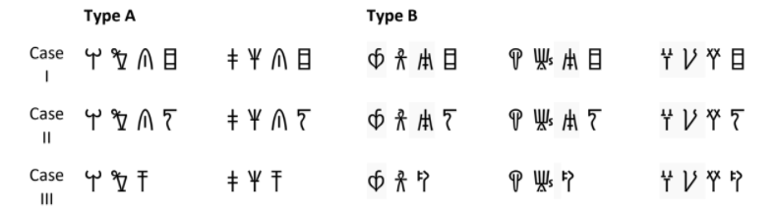
Creating the Connections
Kober showed how characters are connected
  Computerise this process
Predictable patterns, evidence of inflection
Then this is plot on a graph
Ser-vu-s(a) -> Servus
Ser-vu-m(a) -> Servum
Ser-vi -> Servi
Same word – different case
First characters are the same, next character likely shares a consonant
Character is the same, the next character likely shares a vowel
mo
wo
no
we
wi
ni
Notes:
9

Slide 10
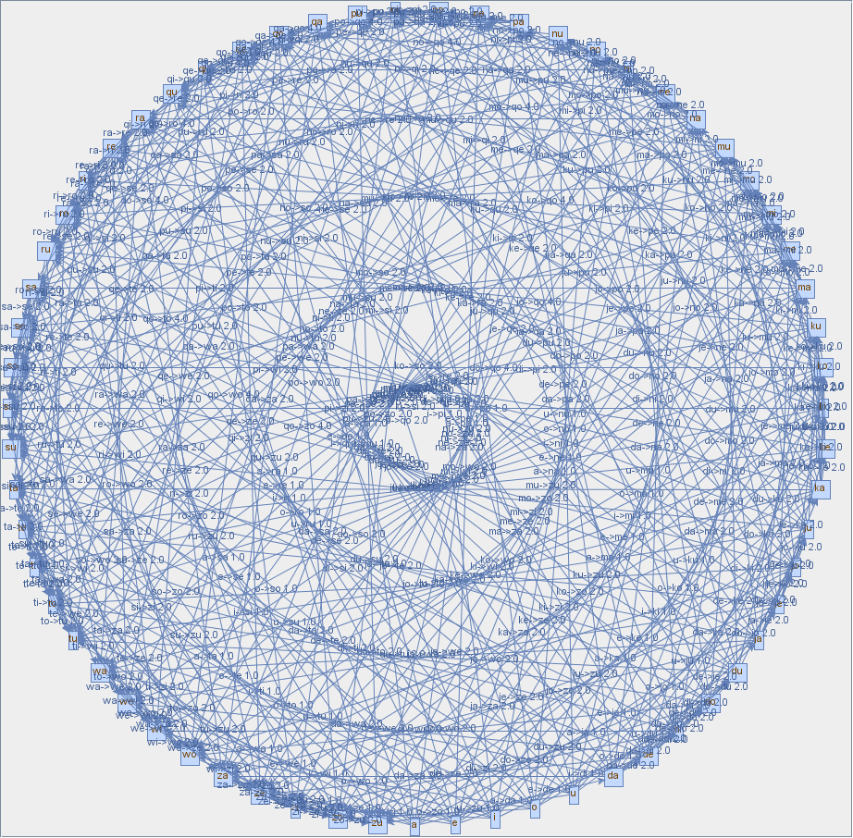
Connection Results
Graph
  Node -> A Linear B character
  Edge -> A shared vowel or consonant
  Weight -> How often it appears
Plot onto a table

Slide 11
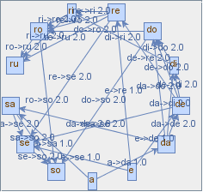
Final Grid
 | A | E | I | O | U
 | a | e | i | o | u
M | ma | me | mi | mo | mu
N | na | ne | null | no | nu
D | da | de | di | do | du
J | ja | je | ni | jo | ju
K | ka | ke | ki | ko | ku
P | pa | pe | pi | po | pu
Q | qa | qe | qi | qo | qu
R | ra | re | ri | ro | ru
S | sa | se | si | so | su
T | ta | te | ti | to | tu
Z | za | ze | zi | zo | zu
W | wa | we | wi | wo | null

Slide 12
Conclusion
It is possible to replicate the decipherment of Linear B computationally
  Different approach that typical Machine Learning decipherments
Working with limitations can encourage creative solutions
  Graph approach - computers are very good at working with them!
Interdisciplinary projects are great sources of personal growth
  Archaeology and Computer Science
  These can join together!
    Algorithms from unexpected sources
    Spend more time with non-computer scientists
      More creative solutions to problems
    Changed how I approach problems

Slide 13
Thank you for listening
Any Questions?
 @InsiderPhD
→ K.Paxton-Fear@cranfield.ac.uk
 medium.com/@InsiderPhD/
 https://github.com/greenpencil
My Linear B datasets are available and free for use
https://github.com/InsiderPhD/Linear-B-Dataset
My inflection algorithm is available and free for use
https://github.com/greenpencil/Java-Inflection-Algorithm

